Slide 1
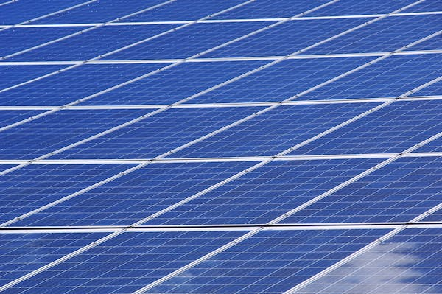
SOLAR PANEL PREDICTIVE MAINTENANCE PROJECT
By Muhammad Aqhari Nasrin Bin Ramli

Slide 2
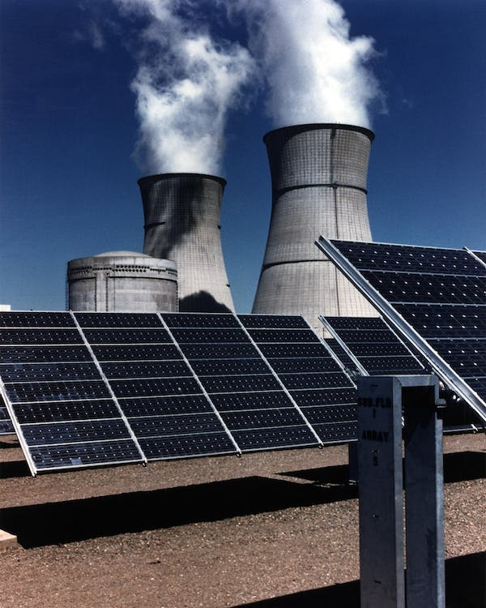
PROBLEM STATEMENT
Electricity plays a crucial role in manufacturing operations.
50% of energy costs attributed to electrical power (Matthes et al. 2018).
Renewable Energy Integration : Solar Energy
To reduce operations cost
The IR 4 prioritizes clean and renewable energy (George 2020).

Slide 3
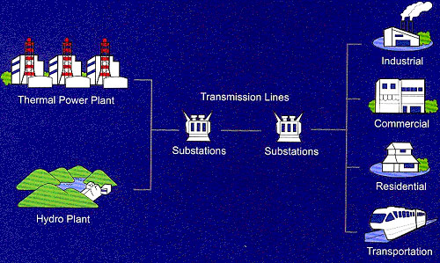
Thermal Power Plant
produces power by using conventional steam turbine and steam generator principally fired by coal, oil or natural gas (steam power plant)
Hydroelectric Power Plants
utilization of energy from flowing water to electrical energy.
Source : Tenaga Nasional Berhad (TNB)

Slide 4
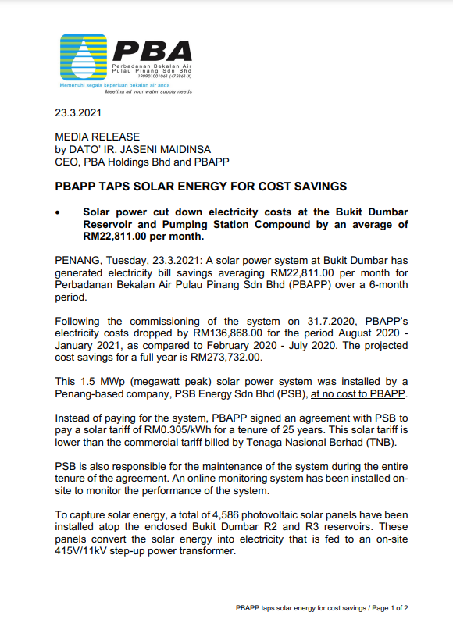
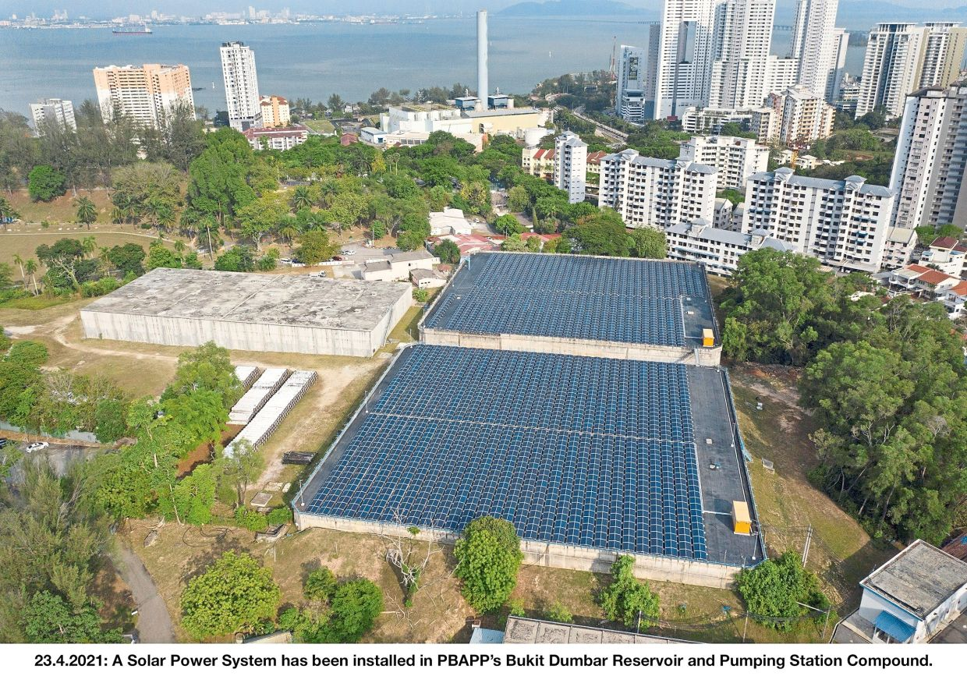
Perbadanan Bekalan Air Pulau Pinang (PBAPP) reduced monthly electricity costs by an average of RM22,811.00, resulting in annual savings of RM273,732.00.

Slide 5
OBJECTIVE
To reduce the manufacturing operations cost by increasing the efficiency of the Photovoltaic Solar(PV) Panel using Predictive Maintenance model.
Photovoltaic Solar (PV) Panel
A technology that converts sunlight directly into electricity using solar cells (Priscila et al., 2017).
Efficiency
The maintenance of these plants still need improvement in order to enhance their efficiency (Ana et al., 2018).
Predictive Maintenance(PdM) Model
estimate time to failure in PV arrays, enabling users to take preventive and corrective measures before actual failures occur (Lin et al., 2019).

Slide 6
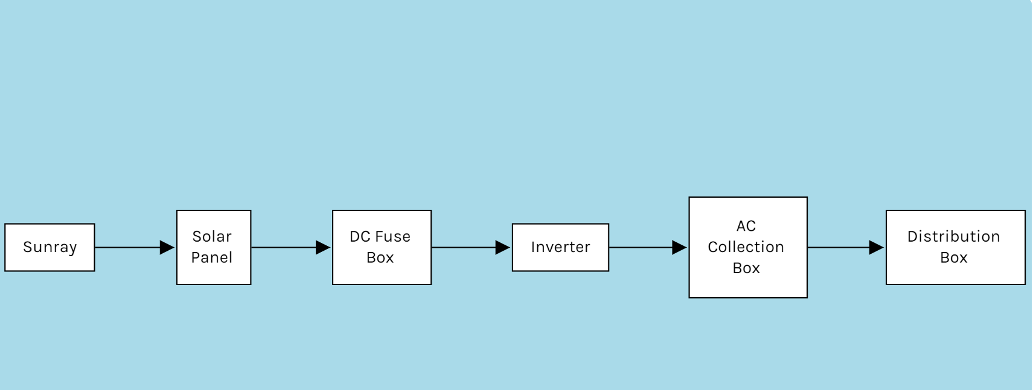
SOLAR POWER GENERATION FLOWCHART

Slide 7
DATA DESCRIPTION
Source: Kaggle.com
Link: https://www.kaggle.com/datasets/anikannal/solar-power-generation-data
Plant 1:
Plant 2:

Slide 8
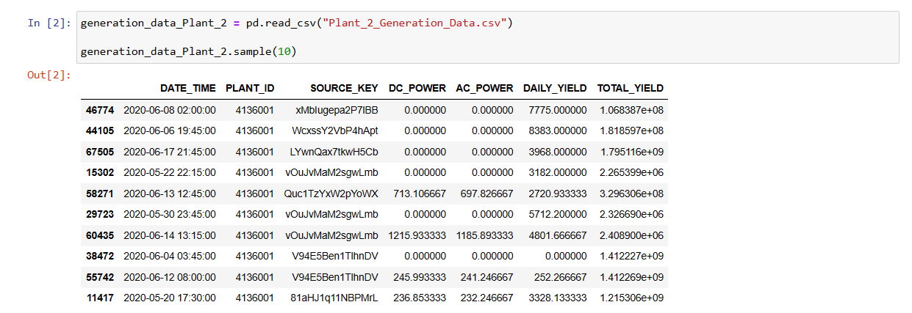
GENERATION_DATA_PLANT_2

Slide 9
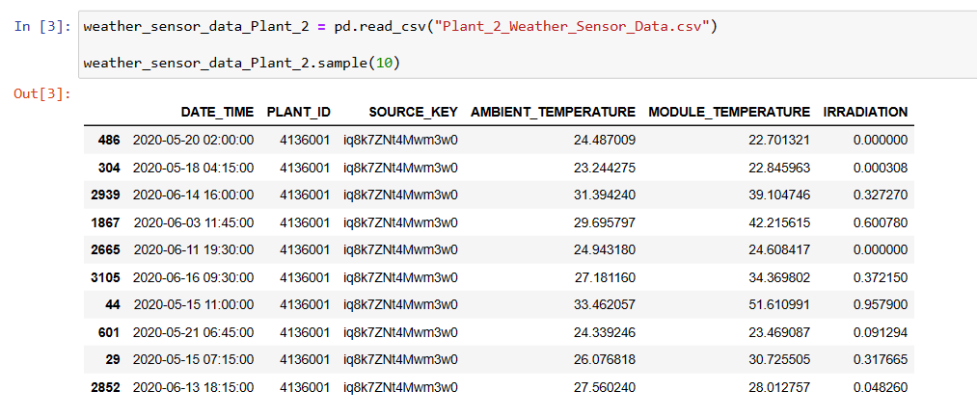
WEATHER_SENSOR_DATA_PLANT_2

Slide 10
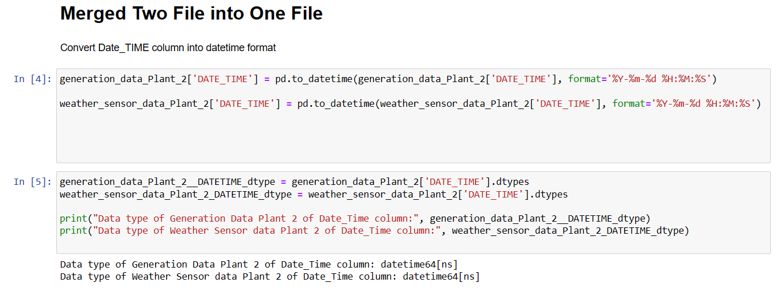
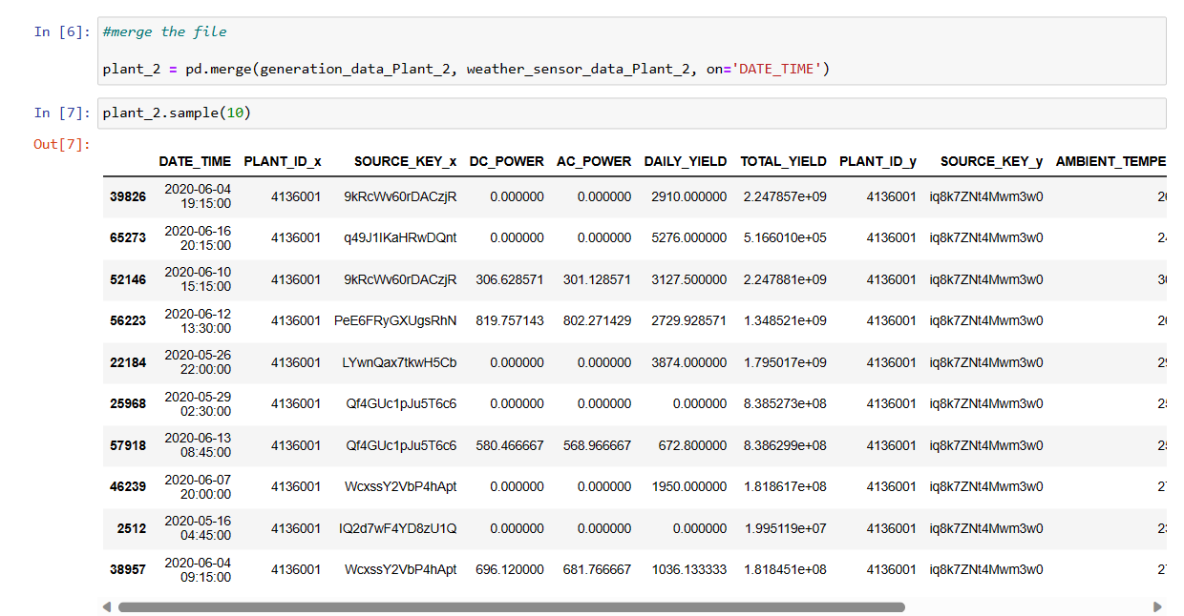

Slide 11
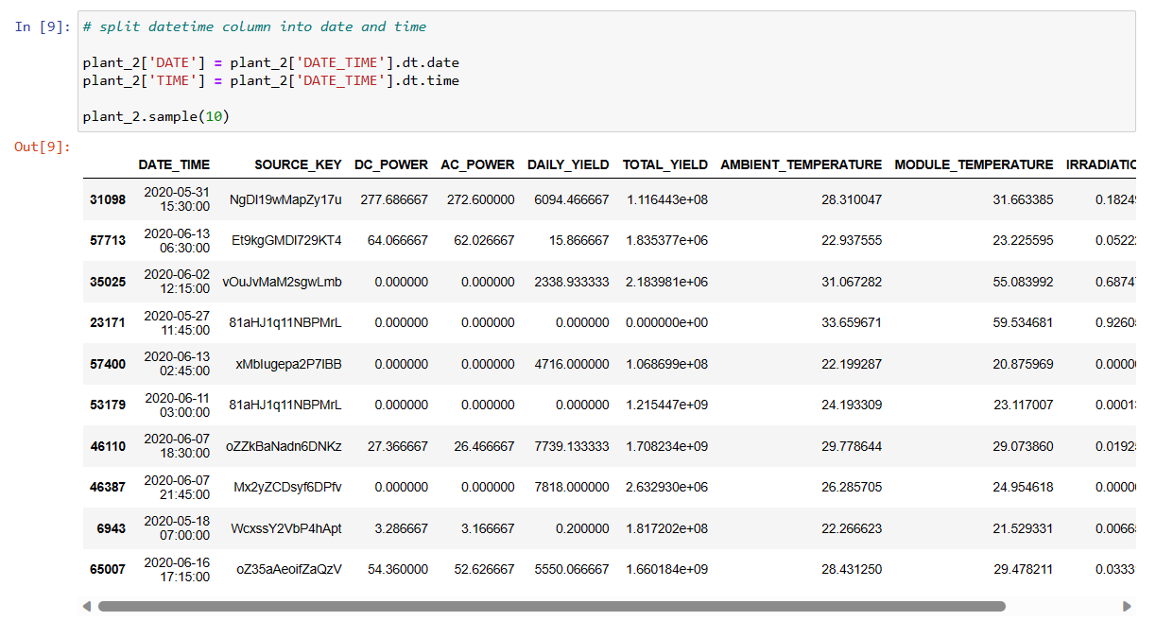
SPLIT DATE_TIME COLUMN INTO DATE AND TIME COLUMNS

Slide 12
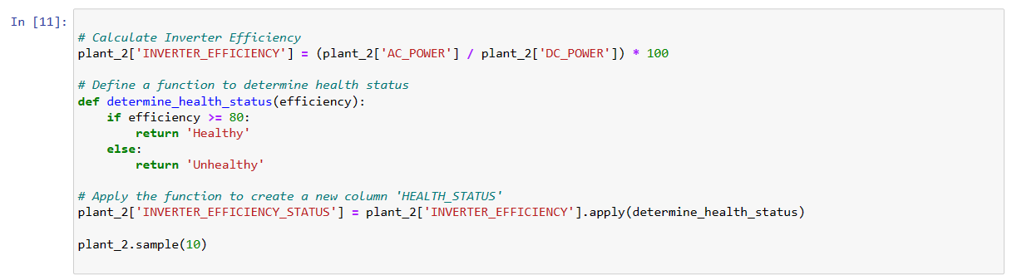
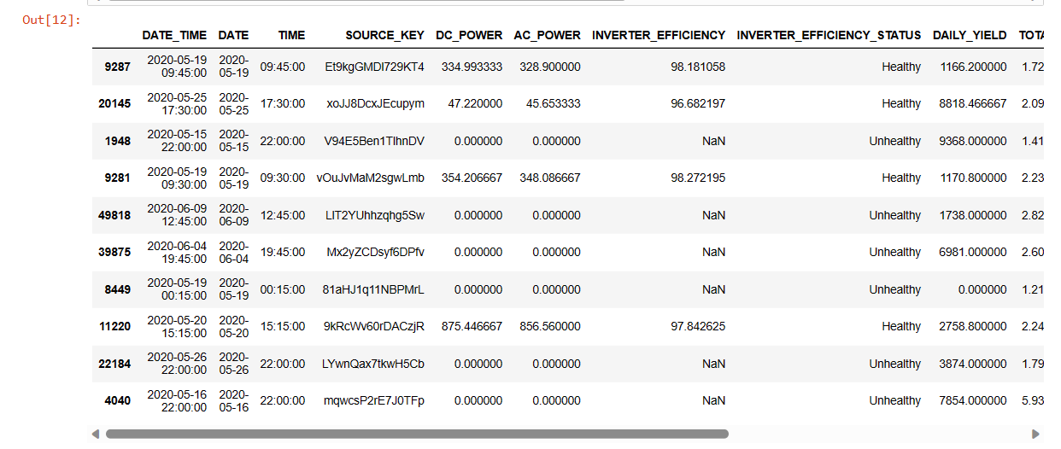
INVERTER EFFICIENCY
Indicator for the health of solar panel systems.
Higher inverter efficiency indicates that the solar panels are able to convert more sunlight into electricity efficiently.

Slide 13
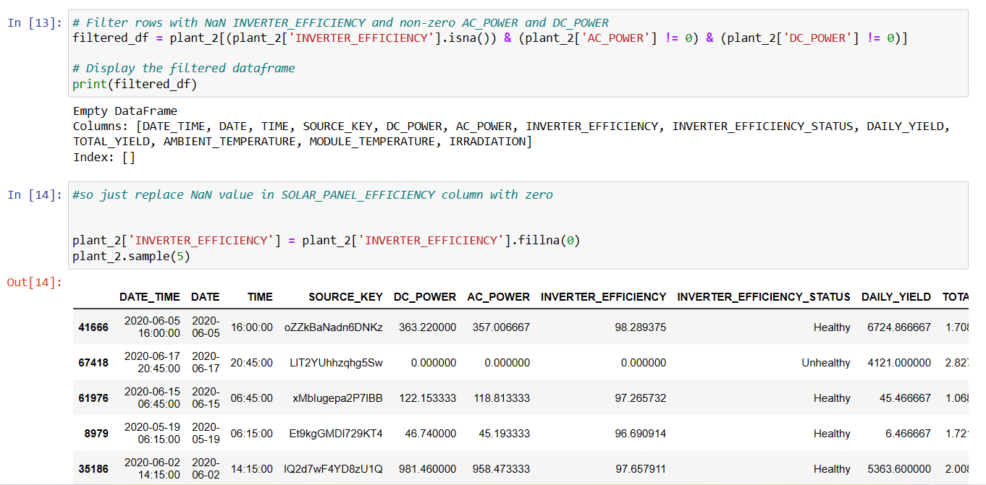

Slide 14
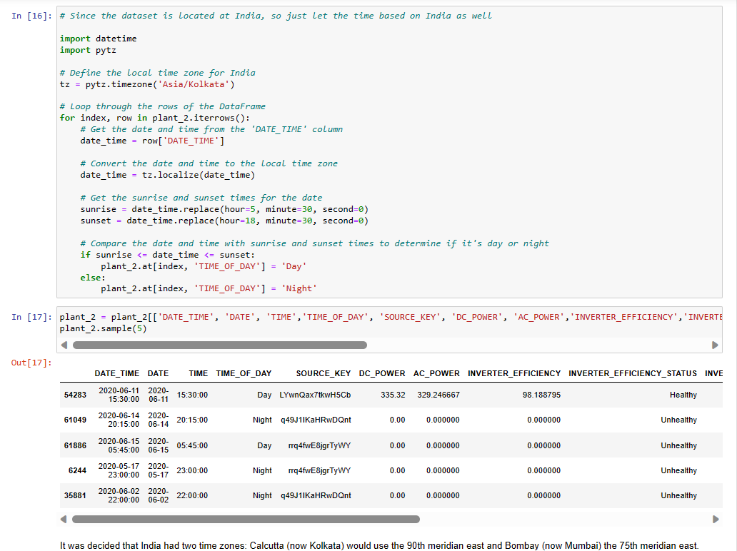

Slide 15
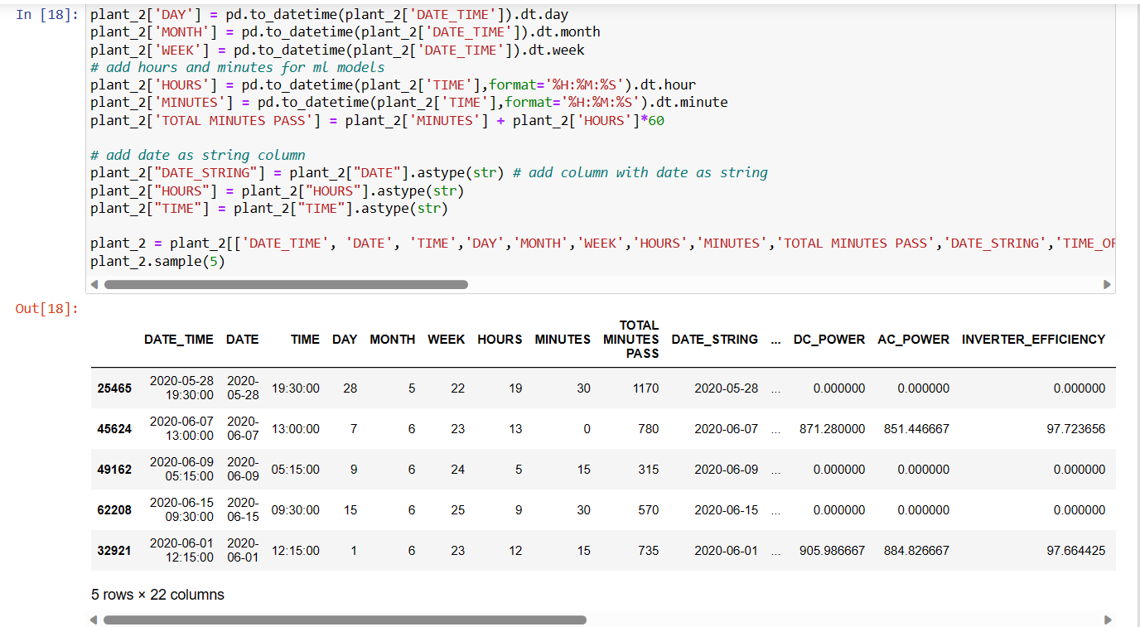

Slide 16
EXPLORATORY DATA ANALYSIS

Slide 17
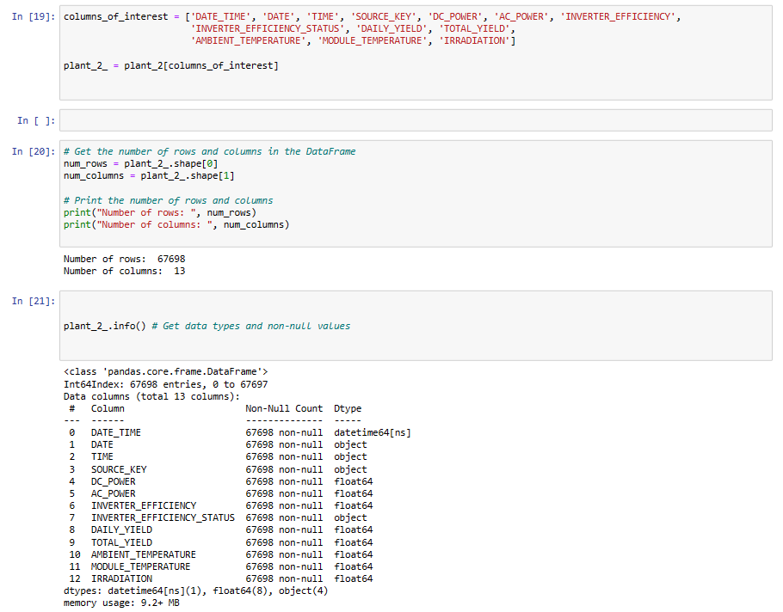

Slide 18
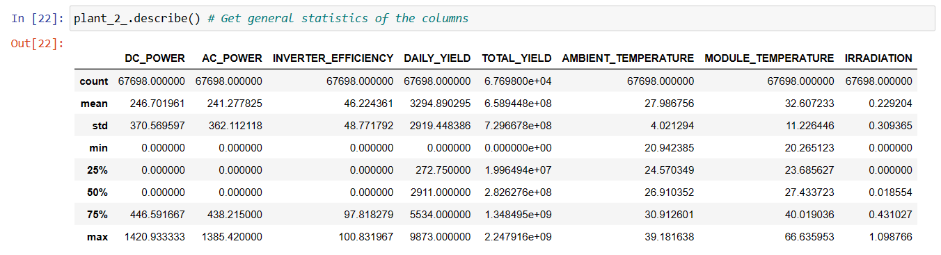

Slide 19
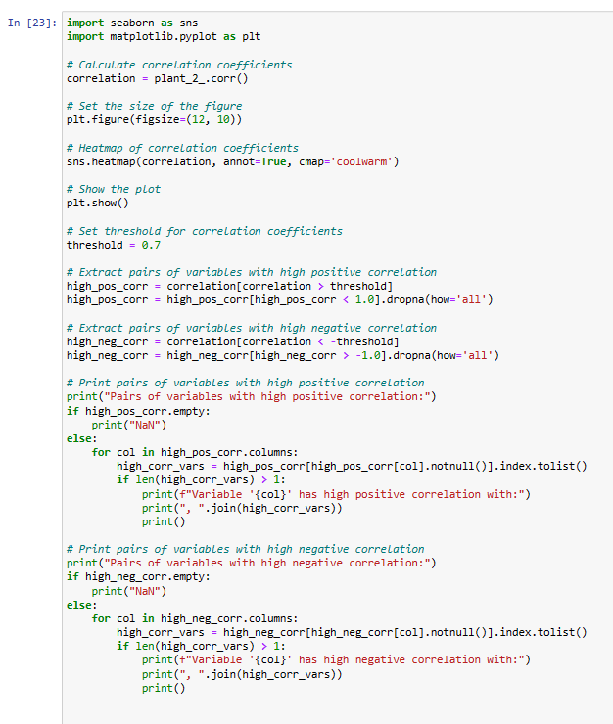
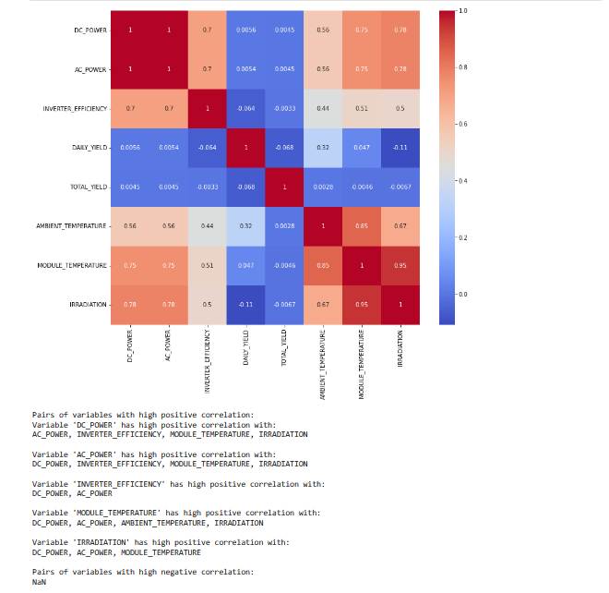

Slide 20
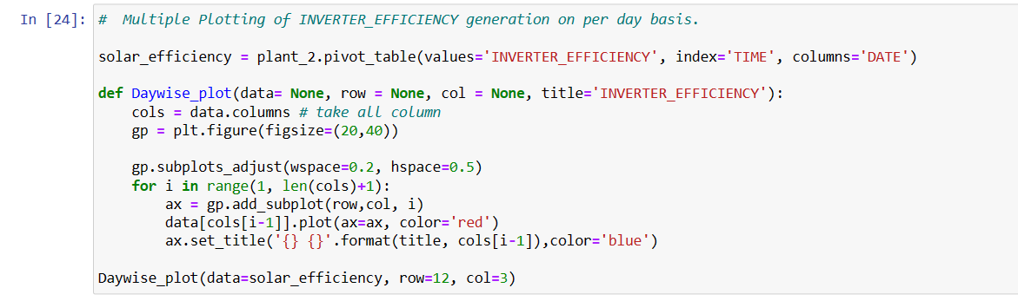
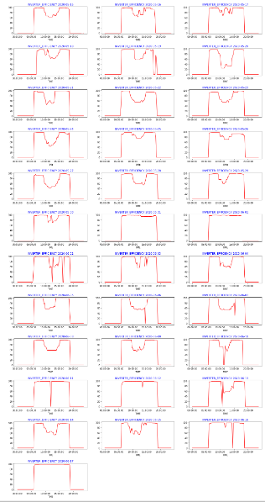

The analysis of the inverter efficiency data revealed noticeable fluctuations on a per-day basis.
Variability observed throughout different times per day
Inverter efficiency consistent on 2020-06-17

Slide 21
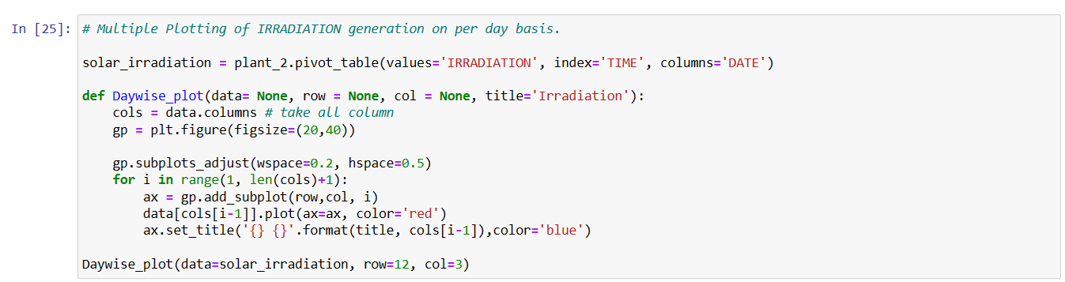
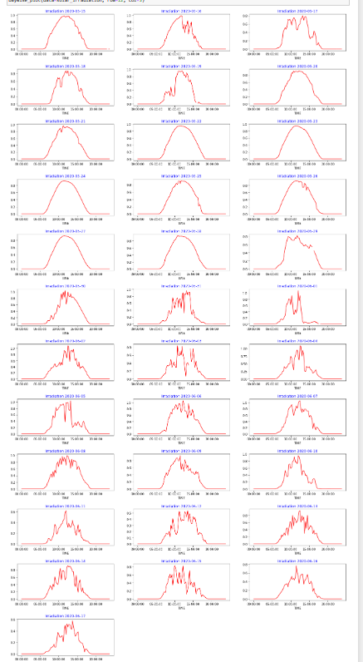
The analysis indicated that Inverter Efficiency and Irradiation do not exhibit a direct and consistent relationship
Higher Irradiation doesn't always lead to improved Inverter Efficiency.
Some days with sufficient Irradiation showed inconsistent Efficiency
For instance, despite the Inverter Efficiency stabilizing, significant fluctuations in Irradiation were observed on 2020-06-17.

Slide 22
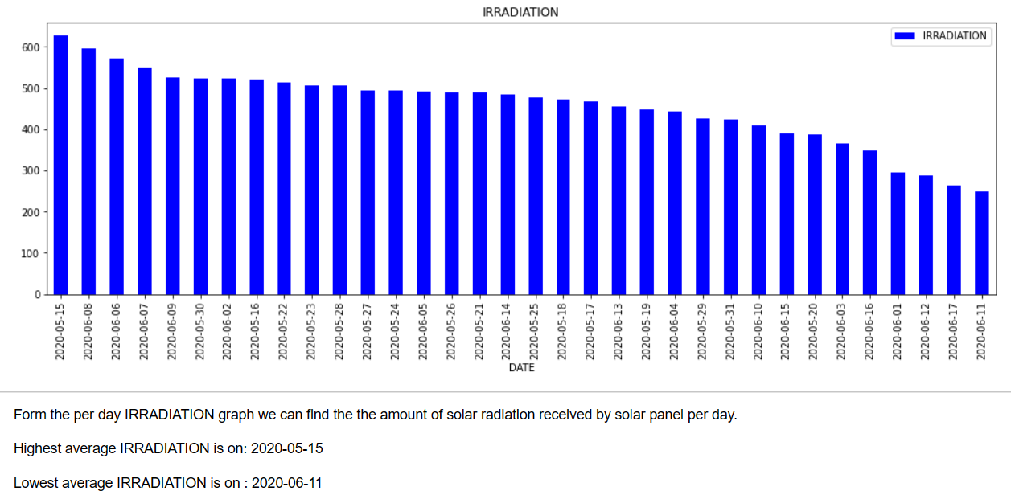

Slide 23
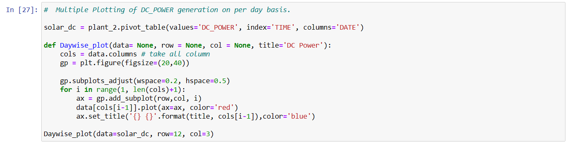
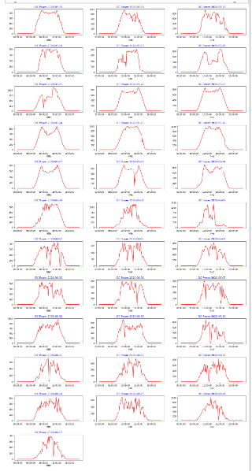
The analysis indicates that 'DC_POWER' has a noticeable impact on 'INVERTER_EFFICIENCY’.
As 'DC_POWER' increases, the 'INVERTER_EFFICIENCY' tends to increase as well, indicating a positive relationship between these two variables.
The analysis revealed a positive correlation between 'IRRADIATION' and 'DC_POWER', indicating that higher levels of 'IRRADIATION' are associated with increased 'DC_POWER' generation..

Slide 24
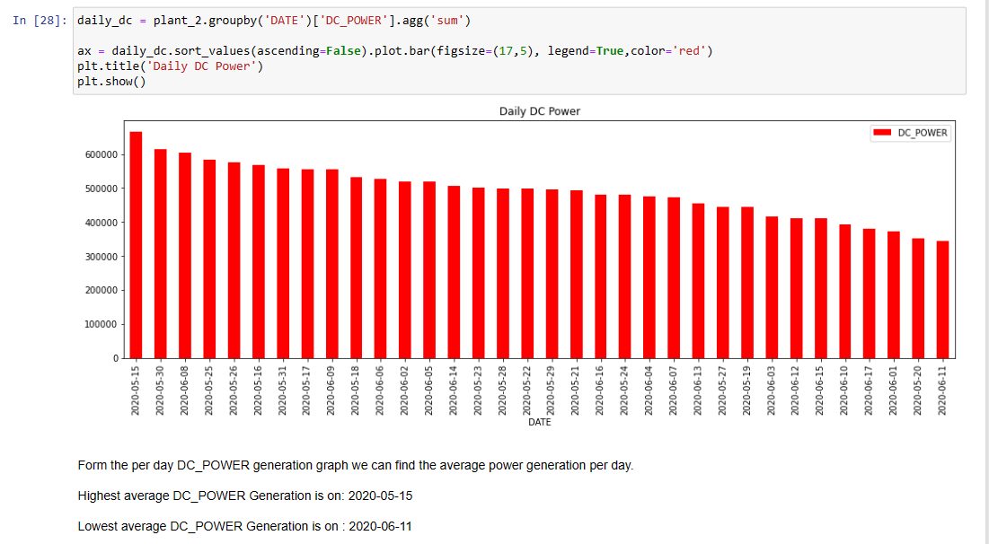

Slide 25
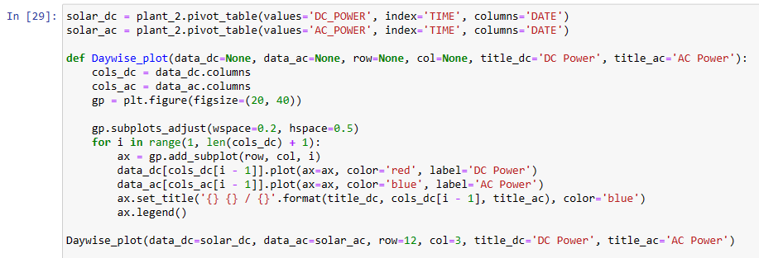
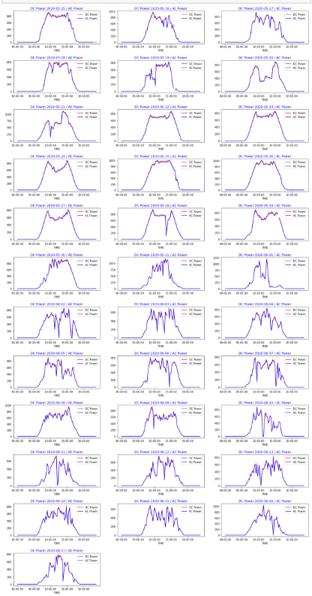

Slide 26
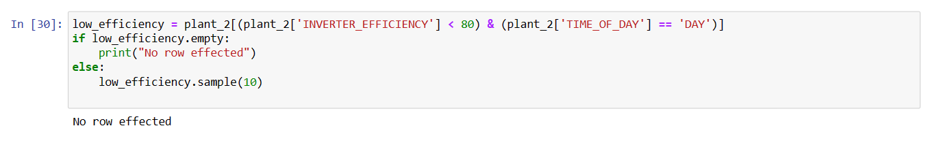
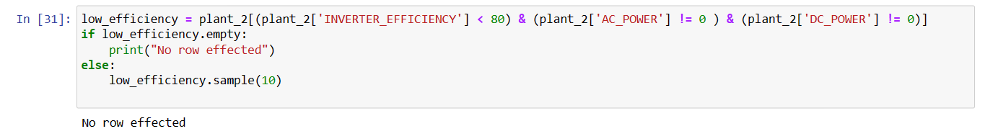
The inverter appears to be functioning well, as no rows were found to be affected by low inverter efficiency during the day.
The inverter appears to be functioning well, as no rows were found to be affected by low inverter efficiency and DC_POWER is not zero.

Slide 27
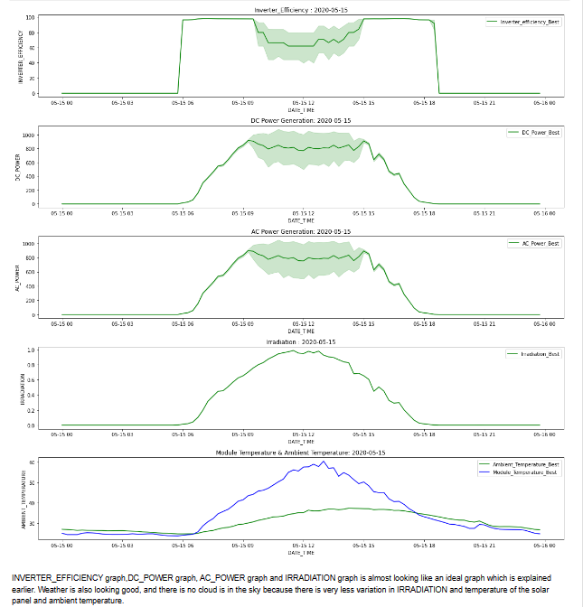

Slide 28
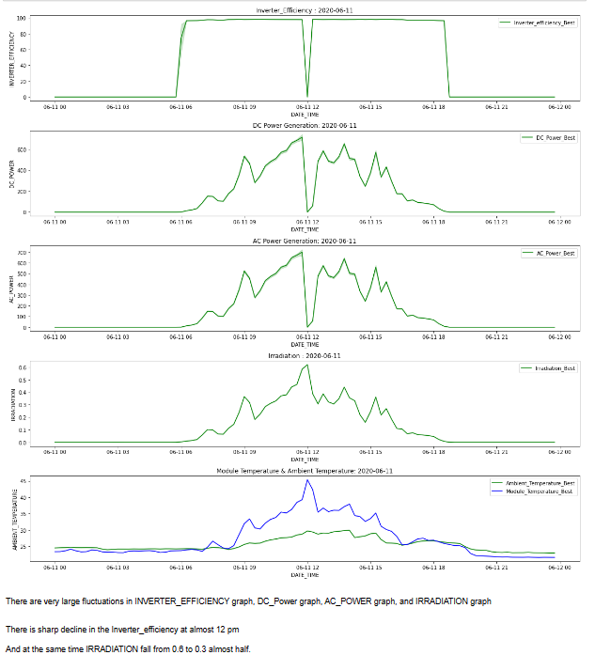

Slide 29
CONCLUSIONS FROM EXPLORATORY DATA ANALYSIS
Irradiation levels impact solar power plant performance.
DC_POWER generation affected by irradiation changes.
AC_POWER generation influenced by DC_POWER.
Inverter efficiency linked to AC_POWER generation.
Higher irradiation boosts power generation and efficiency.
Lower irradiation reduces power generation and efficiency.

Slide 30

RECOMMENDATION MEASUREMENTS
Batteries

Slide 31
MACHINE LEARNING PREPARATION

Slide 32
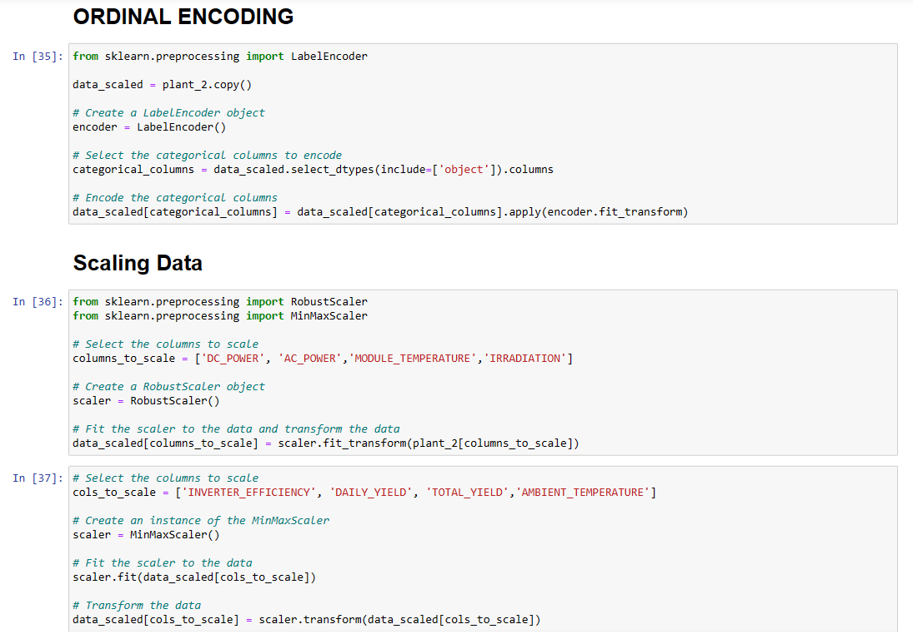

Slide 33
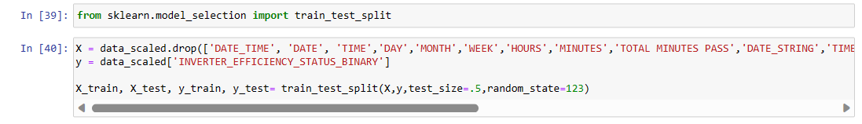
SPLIT THE DATA SET

Slide 34
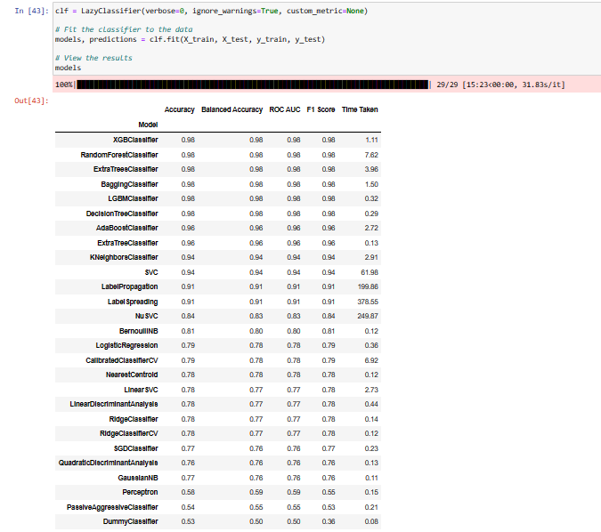

Slide 35
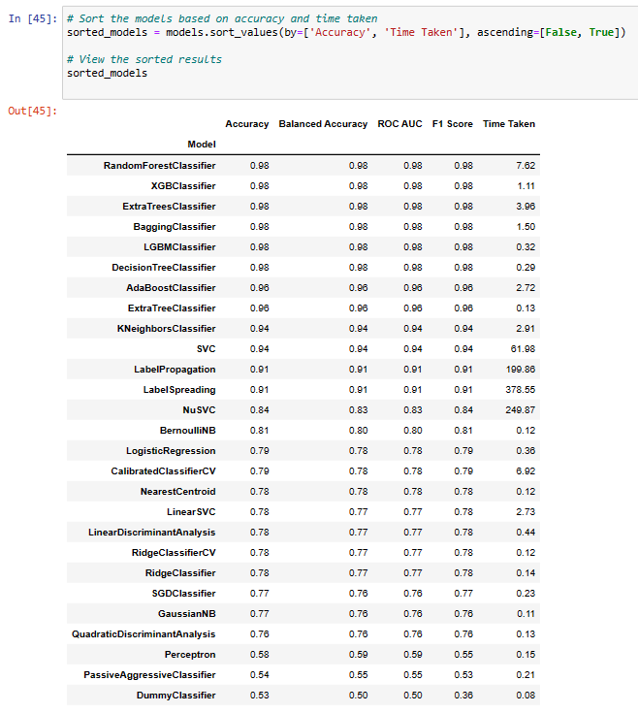

Slide 36
FUTURE WORKS
Train data with total power usage of the manufacturing plants
Implementing more maintenance measurement for Solar Panel
Implementing the weather forecast to ensure the efficiency of Solar Panel

Slide 37
THANK YOU

